Slide 1
Unsupervised Learning

Slide 2
Unsupervised Learning Tasks
Dimensionality Reduction
Clustering
Anomaly Detection
Density Estimation

Slide 3
Clustering Applications
Customer Segmentation
Data analysis
As a dimensionality reduction technique
Feature engineering
Anomaly Detection
Semi supervised learning

Slide 4
Techniques
Some algorithms look for instances centered around a particular point, called a centroid.
Others look for continuous regions of densely packed instances: these clusters can take on any shape.
Some algorithms are hierarchical, looking for clusters of clusters.
And the list goes on.

Slide 5
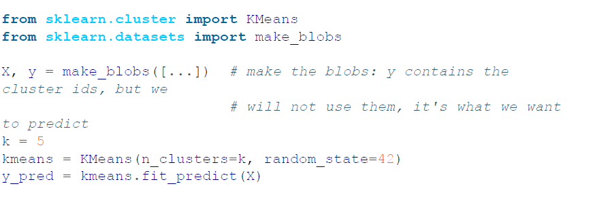
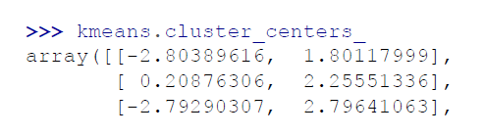
K-means

Slide 7
Hard vs Soft Clustering
Instead of assigning each instance to a single cluster, which is called hard clustering, it can be useful to give each instance a score per cluster, which is called soft clustering
The score can be the distance between the instance and the centroid; conversely, it can be a similarity score (or affinity), such as the Gaussian Radial Basis Function
In the KMeans class, the transform() method measures the distance from each instance to every centroid:

Slide 8
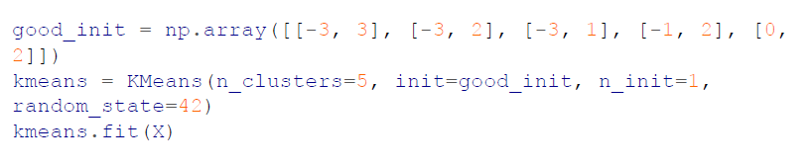
Centroid Initialization Methods
If you happen to know approximately where the centroids should be (e.g., if you ran another clustering algorithm earlier), then you can set the init hyperparameter to a NumPy array containing the list of centroids, and set n_init to 1:

Slide 9
Centroid Initialization Methods
Another solution is to run the algorithm multiple times with different random initializations and keep the best solution. The number of random initializations is controlled by the n_init hyperparameter: by default, it is equal to 10, which means that the whole algorithm described earlier runs 10 times when you call fit(), and Scikit-Learn keeps the best solution.
It uses a performance metric! That metric is called the model’s inertia, which is the sum of the squared distances between the instances and their closest centroid.

Slide 10
Improvements of K-means
K-Means++, was proposed in a 2006 paper by David Arthur and Sergei Vassilvitskii. They introduced a smarter initialization step that tends to select centroids that are distant from one another.
Another improvement to the K-Means algorithm was proposed in a 2003 paper by Charles Elkan. On some large datasets with many clusters, it can accelerate the algorithm by avoiding many unnecessary distance calculations.
Yet another important variant of the K-Means algorithm was proposed in a 2010 paper by David Sculley. Instead of using the full dataset at each iteration, the algorithm is capable of using mini-batches, moving the centroids just slightly at each iteration

Slide 11
Silhouette diagram

Slide 12
Limits of K-means
It is necessary to run the algorithm several times to avoid suboptimal solutions
You need to specify the number of clusters, which can be quite a hassle.
Moreover, K-Means does not behave very well when the clusters have varying sizes, different densities, or nonspherical shapes.

Slide 13
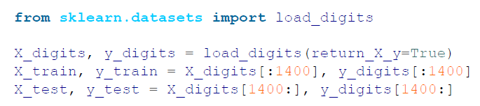
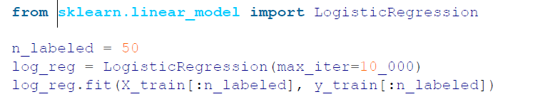
Using Clustering for Semi-supervised Learning
Load digits data
Let’s pretend we have 50 labeled instances

Slide 14
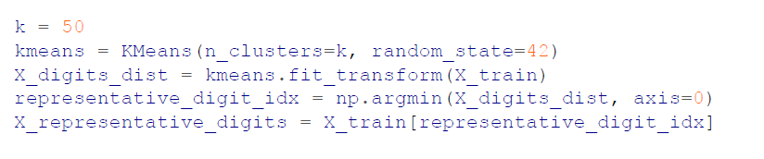
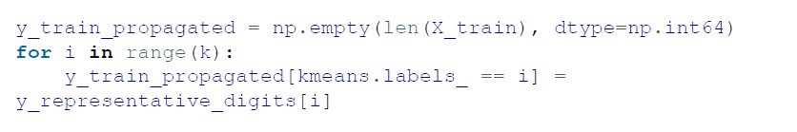
Lcluster the training set into 50 clusters. Then for each cluster, let’s find the image closest to the centroid. Let’s call these images the representative images
We could manually label the representative digits, or we could propagate the labels

Slide 15
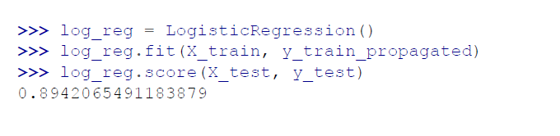
Now let’s look the model’s performance
we can do even better by ignoring the 1% instances that are farthest from their cluster center: this should eliminate some outliers
Scikit-Learn also offers two classes that can propagate labels automatically: LabelSpreading and LabelPropagation in the sklearn.semi_supervised package

Slide 16
DBSCAN
This algorithm defines clusters as continuous regions of high density.
For each instance, the algorithm counts how many instances are located within a ε-neighborhood
If an instance has at least min_samples instances in its ε-neighborhood (including itself), then it is considered a core instance
All instances in the neighborhood of a core instance belong to the same cluster
Any instance that is not a core instance and does not have one in its neighborhood is considered an anomaly.

Slide 17
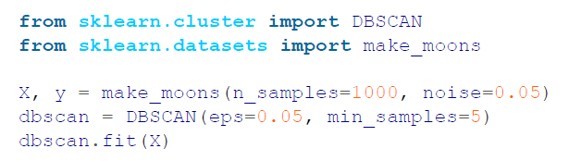
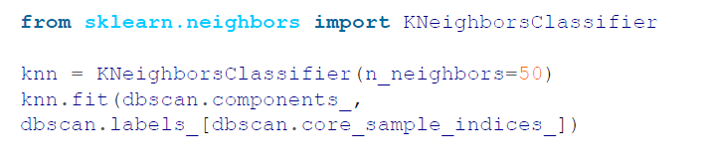
DBSCAN
works well if all the clusters are well separated by lowdensity regions.
Does not have a fit method

Slide 19
Gaussian Mixtures
A Gaussian mixture model (GMM) is a probabilistic model that assumes that the instances were generated from a mixture of several Gaussian distributions whose parameters are unknown
All the instances generated from a single Gaussian distribution form a cluster that typically looks like an ellipsoid. Each cluster can have a different ellipsoidal shape, size, density, and orientation

Slide 20
Gaussian Mixtures
There are several GMM variants. In the simplest variant, implemented in the GaussianMixture class, you must know in advance the number k of Gaussian distributions.
GMMs are typically trained using the expectation-maximization (EM) algorithm.
GMMs are a powerful tool for unsupervised learning, and they have been used successfully in a variety of applications.
A Gaussian mixture model is a generative model, meaning you can sample new instances from it

Slide 21
EM algorithm
The expectation-maximization (EM) algorithm is an iterative algorithm that is used to find the maximum likelihood estimates of the parameters of a mixture distribution.
The EM algorithm works by alternating between two steps:
Expectation step (E-step): In the E-step, the algorithm computes the expected value of the log-likelihood function, given the current estimate of the parameters.
Maximization step (M-step): In the M-step, the algorithm maximizes the expected log-likelihood function, given the current estimate of the parameters.

Slide 22
EM algorithm
Expectation-Maximization (EM) algorithm has many similarities with the K-Means algorithm:
It also initializes the cluster parameters randomly, then repeats two steps until convergence
First assigning instances to clusters (this is called the expectation step)
Then updating the clusters (this is called the maximization step).

Slide 25
Tuning Hyperparameter
When there are many dimensions, or many clusters, or few instances, EM can struggle to converge to the optimal solution.
You might need to reduce the difficulty of the task by limiting the number of parameters that the algorithm has to learn. One way to do this is to limit the range of shapes and orientations that the clusters can have. This can be achieved by imposing constraints on the covariance matrices.
To do this, set the covariance_type hyperparameter

Slide 26
Outlier/ Novelty Detection

Slide 27
Selecting the Number of Clusters
With K-Means, you could use the inertia or the silhouette score to select the appropriate number of clusters.
But with Gaussian mixtures, it is not possible to use these metrics because they are not reliable when the clusters are not spherical or have different sizes.
Instead, you can try to find the model that minimizes a theoretical information criterion, such as the Bayesian information criterion (BIC) or the Akaike information criterion (AIC)

Slide 28
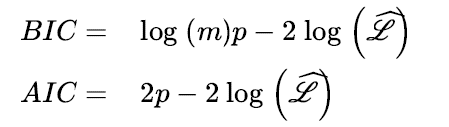
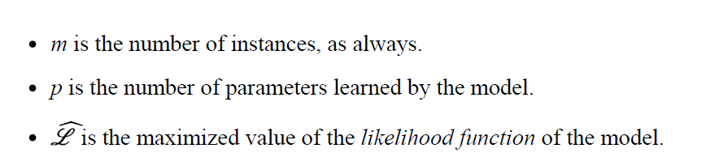
Selecting the Number of Clusters
In these equations

Slide 29
AIC vs BIC
Both the BIC and the AIC penalize models that have more parameters to learn (e.g., more clusters) and reward models that fit the data well.
They often end up selecting the same model.
When they differ, the model selected by the BIC tends to be simpler (fewer parameters) than the one selected by the AIC, but tends to not fit the data quite as well (this is especially true for larger datasets).

Slide 31
Bayesian Gaussian Mixture Models
Rather than manually searching for the optimal number of clusters, you can use the BayesianGaussianMixture class, which is capable of giving weights equal (or close) to zero to unnecessary clusters.
Set the number of clusters n_components to a value that you have good reason to believe is greater than the optimal number of clusters (this assumes some minimal knowledge about the problem at hand)

Slide 32
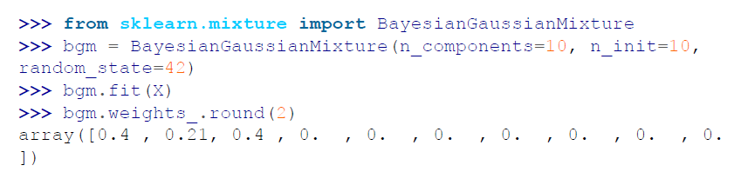

Slide 33
Good for clusters of ellipsoidal shapes

Slide 34
Thank you

